Slide 1
Statistical Analysis on Birth
Objective:
To Analyze the impact of nutritional food and vaccination that may cause death in children under the age of five in rural areas.
By Mark Gershman

Slide 2
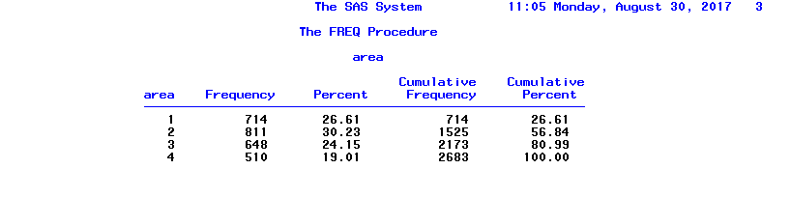
Step 1 – Frequency table of just treatment area
The first thing I did was get proc frequency data for my Birth file.
I target the “Area” in specific with the tables command.
Then I focused on only the “Treatment area”, which is below 4 in “recorded area”.
I then end it with format to associate with a variable.
proc freq data = Mark.Birth;
tables Area;
where area <=4;
run;

Slide 3
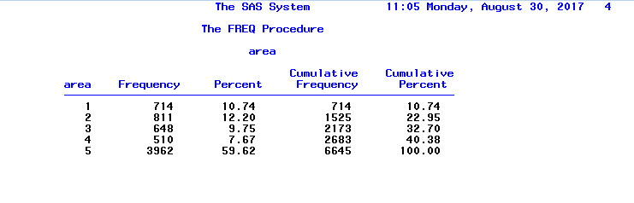
Step 2 – Frequency table of recorded area as a whole
The first thing I did was get the frequency of the entire recorded area, unlike the first step.
I targeted area in specific with the tables command.
proc freq data = Mark.Birth;
tables Area;
run;

Slide 4
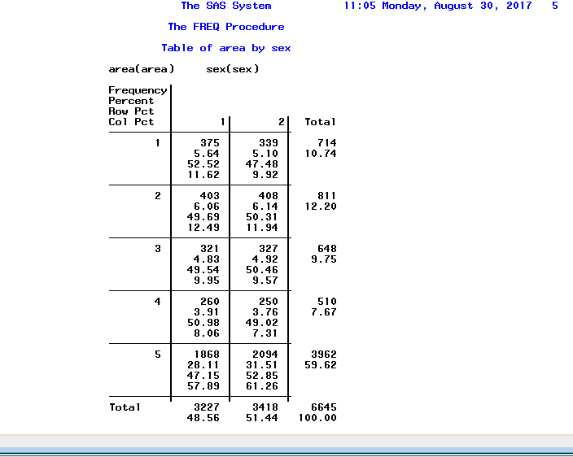
Step 3 – Cross tabulation between recorded area and gender
As I’m creating a contingency table, I use proc freq again.
I go cross tabulate area and gender.
proc freq data = Mark.Birth;
tables Area * Sex;
run;

Slide 5
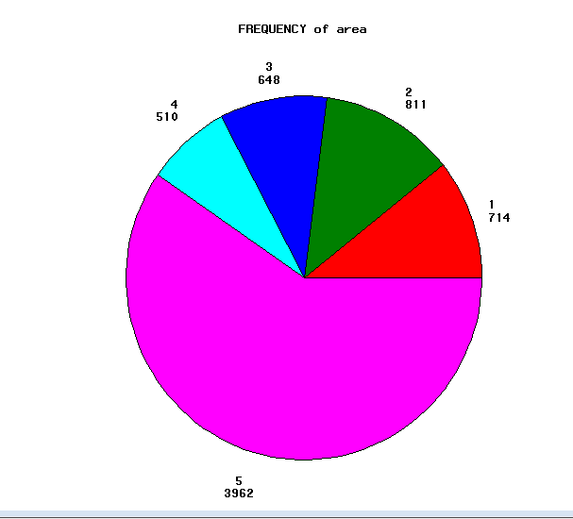
Step 4 – Pie chart of recorded area
Next I run a gchart for pie. This is a pie chart of the recorded area.
I proc gchart.
Then I use pie, targeting area only with the discrete command.
I get the number 3962 for area value, stated as #5.
proc gchart data=Mark.Birth;
pie Area/discrete;
run;

Slide 6
Step 5 – Age at death by recorded area
First, I proc SQL to prepare for a merge since my death file has the death variables.
I create a new name and left join the two based on crid.
proc SQL;
create table Mark.BirthTest as
select * from Mark.birth left join Mark.death
on birth.crid=death.crid;
quit;

Slide 7
Step 5.1
Then I begin creating Age at death by including all the small variable names along the way.
I include <=4 to describe specifically what the treatment is and what the comparison is.
Then I add Age at Death in Months (AADM), which is just day of death minus day of birth with the average number of days in a month (30.46).
data Mark.Birth002;
set Mark.BirthTest;
length recorded_area $ 15;
if area <=4 then recorded_area = "Treatment";
else recorded_area = "Comparison";
AADM=(dod-dob)/30.46;

Slide 8
Step 5.2
Then I give it a format. I also include 6.2, which is 2 whole numbers and 6 decimal points.
Next I link it all together so they correlate.
format aadm 6.2;
yob=year(dob);
mob=month(dob);
yod=year(dod);
mod=month(dod);
run;

Slide 9
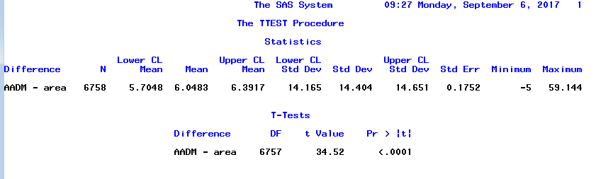
Step 5.3
Then I proc the sample ttest on age at death over recorded area.
proc ttest data=Mark.Birth002;
paired aadm*area;
run;

Slide 10
Step 6 – Chi squared test between recorded area and gender
First I have to include gender as Male/Female instead of numerical.
I include “Gender” as a brand new row in the table, max 8 characters long.
Then I make it so that 1=male and 2=female to prepare for the chi squared.
data Mark.Birth001;
set Mark.Birth002;
length Gender $8;
if sex = 1 then gender ="Male";
if sex = 2 then gender ="Female";
run;

Slide 11
Step 6.1
In order to do sampling, I have to split up the comparison areas.
I start with treatment.
data Mark.Treatment;
set Mark.Birth001;
where area <=4;
run;

Slide 12
Step 6.2
Then I go for Comparison
data Mark.Comparison;
Set Mark.Birth001;
where area =5;
run;

Slide 13
Step 6.3
Then I take the recently created treatment and prepare it for chi squared by getting the calculations.
The total number of both treatment and comparison is P=6758. 2692 for only treatment.
The equation is 2692 divided by 6758 x 650.
Data Mark.Treatment1;
n=5;
P=2692;
do while (n <=258);
Slice=int (p*ranuni(-1));
set Mark.Treatment point=slice;
output;
n=n+1;
end;
stop;

Slide 14
Step 6.4
Now I calculate for the comparison area. 6758 divided by 4066 x 650.
Data Mark.Comparison;
n=1;
P=4066;
do while (n <=391);
Slice=int (p*ranuni(-1));
set Mark.Comparison point=slice;
output;
n=n+1;
end;
stop;
run;

Slide 15
Step 6.5
Then I have to merge both files to prepare for the final step.
data Mark.CompTreat;
set Mark.Comparison Mark.Treatment1;
run;

Slide 16
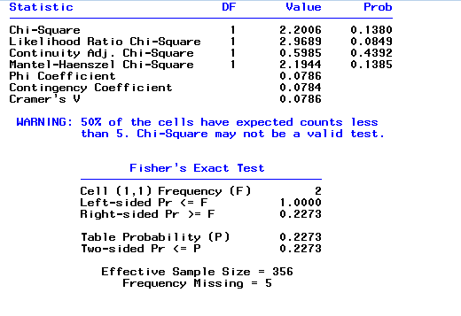
Step 6.6
I run based on gender and recorded area.
proc freq data= Mark.CompTreat;
tables Gender*Recorded_area/chisq;
run;

